Slide 1
Faculty Senate Meeting
June 11, 2020

Slide 2
Agenda
Call to Order and Roll Call
K. Homan, Secretary

Slide 3
Agenda
Approval of Minutes
April 16, 2020

Slide 4
Agenda
III. Campus Reports
A. Staff Council, B. Spencer

Slide 5
Agenda
III. Campus Reports
B. Student Council, K. Kessinger
-NO REPORT

Slide 6
Agenda
IV. President’s Report
S. Corns

Slide 7
President’s Report
Dr. Steven Corns, Faculty Senate President

Slide 8
Committee Updates
Bylaw Revisions Committee
Tom Schuman compiling last drafts, should be available soon
Budgetary Affairs Committee: Report today
Information on potential salary reduction
Facilities Planning Committee
Requesting information on status of ongoing and upcoming construction projects

Slide 9
Committee Updates
Tenure Policy Committee
No report, no plans to change tenure and promotion cycle for 2020-2021
Intellectual Property Committee
No report, plan to discuss membership on new Chancellor committee to review intellectual property

Slide 10
Intercampus Faculty Cabinet (IFC)
Statement on being prepared to move to remote learning
Intercampus Faculty Cabinet statement agrees that it is good to be prepared to move courses online
There is no mandate on how faculty will teach courses

Slide 11
Intercampus Faculty Cabinet (IFC)
Last IFC meeting, May 22
University of Missouri benefits changing
No longer using TIAA-CREF
Updates will be given at BOC meeting June 18-19
Budget update
Still looking at a shortfall for FS at all campuses
Updates on promotion and tenure CR&Rs

Slide 12
Intercampus Faculty Cabinet (IFC)
Last IFC meeting, May 22
Discussion with Curators Chatman and Graham
Discussion on the merger of UM System President and University of Missouri – Columbia Chancellor
Discussion on the merger of UM and University of Missouri – Columbia administration
Challenges of working remote

Slide 13
Policy Changes
Reopening of Laboratories
Some labs have been reopened with limited capacity
Department chairs and center directors now can give access

Slide 14
Policy Changes
HR 720 changes
General Temporary Salary Reductions
Criteria-Based Salary Reductions
Salary and FTE Reductions for Employees on Term Academic Appointments

Slide 15
Agenda
V. Reports of Standing Committees with Time-Sensitive Motions
A. Curricula
S. Raper

Slide 16
CCC Meetings
6 May
12 August (upcoming, Fall ECs submitted by 10 July)
Total Committee Activity
1 Name change request (NC forms)
14 Certificate program (PC forms)
27 Degree change request (DC forms)
30 Course change requests (CC forms)
7 Experimental course requests (EC forms)

Slide 17
Program Name Changes (NC) Requested
File 2 BIOLOGICAL SCIENCE
Certificate Programs (PC) Requested
File: 292.2 AI-CT: AI, Mach Lrn & Auto for Bus CT
File 254.8 AUTOEN-CTU: Undergraduate Certificate in Automation Engineering
File 291.2 MGTLEAD-CT: Management and Leadership
File 358 PROPOSED: Advanced Engineering Materials Certificate
File 351 PROPOSED: Geoanalytics and Geointelligence Certificate

Slide 18
Certificate Programs (PC) Requested
File 346 PROPOSED: Geoenvironmental Science and Engineering CT
File 350 PROPOSED: Geologic Hazards Certificate
File 356 PROPOSED: Iron and Steel Metallurgy Certificate
File 357 PROPOSED: Materials for Extreme Environments Certificate
File 353 PROPOSED: Space Resources Certificate
File 352 PROPOSED: Subsurface Water Resources Certificate
File 305.2 PSYMTRP-CT: Statistical Methods Psych CT
File 275.2 STRENG-CT: Contemporary Struct Engr CT
File 304.10 WORKSPY-CT: Applied Workplace Psych CT

Slide 19
Degree Program Changes (DC) Requested
File 142.45 AP MATH-BS: Applied Mathematics BS
File 7.14 AP MATH-MS: Applied Mathematics MS
File 230.16 AUTOEN-MI: Minor in Automation Engineering
File 146.25 BIO SC-BA: Biological Sciences BA
File 14.13 CH ENG-MS: Chemical Engineering MS
File 23.5 COGNEUR-MI: Cognitive Neuroscience Minor
File 156.33 GE ENG-BS: Geological Engineering BS
File 201.1 GE ENG-DE: Geological Engineering DE
File 61.4 GE ENG-MI: Geological Engineering Minor
File 165.27 GE ENG-MS: Geological Engineering Overview

Slide 20
Degree Program Changes (DC) Requested
File 268.7 GE ENG-MS: Geological Engineering MS
File 68.7 GEOT-ME: Geotechnics ME
File 64.47 GL&GPH-BS: Geology and Geophysics BS
File 166.19 GL&GPH-MS: Geology and Geophysics MS
File 72.5 I/O PSY-MI: Idus/Organization Psych Minor
File 234.25 INORGPS-MS: Industrial Organization Psychology MS
File 74.10 IST-MI: Information Sci & Tech Minor
File 84.8 MATH-MST: Mathematics MST
File 98.6 MI ENG-MI: Mining Engineering Minor
File 94.2 MNRL PR-MI: Mineral Process Eng Minor

Slide 21
Degree Program Changes (DC) Requested
File 190.1 MUSIC-MI: Music Minor
File 108.42 PE ENG-BS: Petroleum Engineering BS
File 171.2 PE ENG-MS: Petroleum Engineering MS
File 355 PROPOSED: Geological Engineering PhD
File 192.36 PSYCH-BA: Psychology BA
File 192.32 PSYCH-BS: Psychology BS
File 136.1 THEATRE-MI: Theatre Minor

Slide 22
Course Changes (CC) Requested
File 1116.1 CHEM ENG 5000: Special Problems
File 4700 CIV ENG 5209: Wind Engineering
File 4699 CIV ENG 6141: Principles of Rheology
File 468.8 COMP SCI 1570: Introduction to C++ Programming
File 673.1 ENGLISH 3560: Technical Writing
File 4552 GEO ENG 5810: Fundamentals of Space Resources
File 745.2 GEOPHYS 3210: Introduction to Geophysics
File 259.13 IS&T 3423: Database Management
File 935.8 IS&T 4261: Information Systems Project Management
File 2339.1 IS&T 5423: Foundations of Data Management

Slide 23
Course Changes (CC) Requested
File 2254.6 IS&T 6261: Advanced Information Systems Project Management
File 4695 MUSIC 1144: Jazz Choir
File 4697 MUSIC 1151: Music of Latin America
File 4698 MUSIC 2163: Introduction to Composition and Arranging
File 4706 MUSIC 3253: History of Music in Film
File 1224.1 PHILOS 1105: Self and World: Introduction To Philosophy
File 2226.1 PHILOS 1115: Logic and Reasoning: An Introduction
File 4195.5 PHILOS 1130: How Should I Live? An Introduction to Ethics

Slide 24
Course Changes (CC) Requested
File 2227.1 PHILOS 1175: Religion and the Idea of God: Diverse Perspectives
File 4246.2 PHILOS 3204: Wisdom and Virtue: An Introduction to Ancient Philosophy
File 1754.10 PHILOS 3205: Science, Souls and Skepticism: Early Modern Philosophy
File 4196.4 PHILOS 3302: Philosophy in the Middle Ages
File 4023.8 PHILOS 4325: Who Knows What? Knowledge, Truth and Justification
File 2510.7 PHILOS 4340: From Activism to Zoos: Issues in Social Ethics

Slide 25
Course Changes (CC) Requested
File 1826.7 PHILOS 4360: Who Should Rule and Why? Debates in Political Philosophy
File 1567.1 PSYCH 5600: Advanced Social Psychology
File 4359.7 PSYCH 6602: Employee Affect and Behavior
File 2573.7 PSYCH 6610: Leadership, Motivation, and Culture
File 702.1 TCH COM 5540: Advanced Layout and Design
File 4701 THEATRE 1150: Theatre for Social Change

Slide 26
Curriculum committee moves for FS to approve the DC and CC form actions
Discussion: Questions or comments?

Slide 27
For Informational Purposes; No Senate Approval Required
Experimental Course (EC) Requests
File 4702 ARCH ENG 5001.002: Renewable Systems in the Built Environment
File 4705 BIO SCI 2001.002: Epidemics in a Changing World
File 4696 COMP SCI 5001.002: Applied Social Network Analysis
File 4693 COMP SCI 6001.005: Internet of Things with Data Science
File 4694 GEO ENG 5001.005: Geomechanics for Geoprofessionals
File 4704 MATH 5001.004: Mathematics of Machine Learning
File 4703 MATH 6001.007: Introduction to Uncertainty Quantification

Slide 28
Agenda
V. Reports of Standing Committees with Time-Sensitive Motions
B. Administrative Review
K. Liu

Slide 29
Administrative Review Committee
2019-2020 Members
Diana Ahmad
Wayne Huebner
Bih-Ru Lea
Kelly Liu, Chair

Slide 30
Administrative Review Committee
Positions Reviewed
Vice Chancellor of Research and Dean of Graduate Studies
Vice Chancellor for Student Affairs
Vice Chancellor for University Advancement
Executive Director of Marketing and Communications
Associate Provost for Faculty Affairs
The Review Process
The surveys were loaded onto Qualtrics by Ms. Cheryl McKay after tested extensively.
The surveys took place between Feb. 17 and March 10. Multiple reminders were sent out and the deadline was extended.
The reports were downloaded and reviewed by ARC and FS Officers to identify any inappropriate languages that may reveal the identity of the person completing the review.
The reports have been delivered to the individuals reviewed.
The provost has received the report of AP Faculty Affairs.
The Chancellor has been contacted to deliver the other four reports.

Slide 31
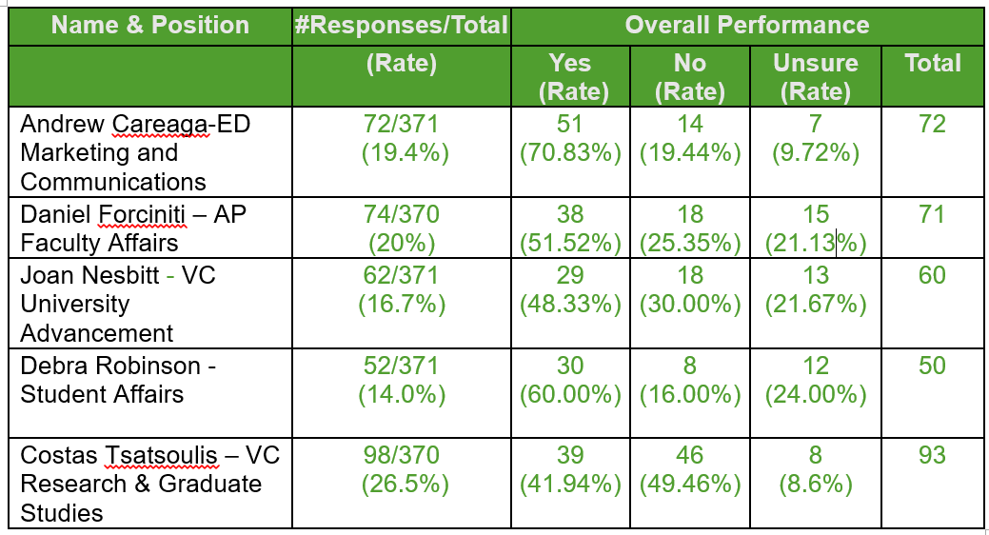
Administrative Review Committee
Responses

Slide 32
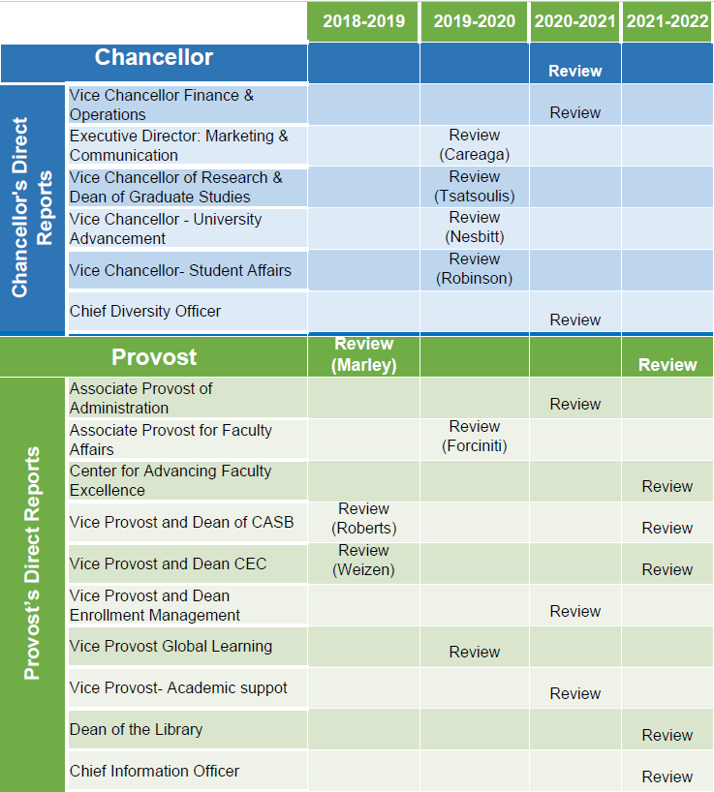
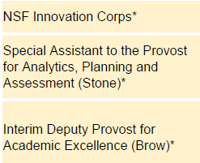
Administrative Review
Schedule
*-Positions not to review

Slide 33
Agenda
V. Reports of Standing Committees with Time-Sensitive Motions
Committee for Effective Teaching D. Oerther

Slide 34
Motion from the Committee on Effective Teaching
Dan Oerther, Chair, CET
11 June 2020
Faculty Senate

Slide 35
Background and Purpose
Curators requested each campus develop historical baseline of effective teaching, plan to improve, and evaluation of improvements.
During 2019-2020, the CET developed a draft report.
This motion is a “mid-point check-in”.

Slide 36
Motion
The committee moves that Faculty Senate:
Adopt the proposed definition of effective teaching;
Acknowledge the historical baseline of effective teaching;
Endorse the proposed roadmap for improving the measurement of effective teaching;
Endorse the proposed roadmap for improving the triangulation of effective teaching; and
Refer the recommendation on the scholarship of teaching and learning for further consideration.

Slide 37
Item 1. Definition of effective teaching
Effective teaching at the Missouri University of Science and Technology is defined as locally optimized instruction – sensitive to students, leveraging faculty expertise, and supported by institutional resources – which achieves measured improvements in the knowledge, skills, and attitudes of students.

Slide 38
Item 2. Baseline of effective teaching
The historical baseline of effective teaching at the Missouri University of Science and Technology is reported as a “CET score,” which is the mean result of student response to the question, “Rate the overall teaching effectiveness of this instructor.”
A Likert-scale is used with a range from 0 (Poor/Strongly Disagree) to 4 (Excellent/Strongly Agree).
Historically, scores below 2.0 can be worthy of concern (per Strategic Plan), while scores above 3.5 can be worthy of recognition (per CAFÉ Awards Program).

Slide 39
Item 3. Improving the measurement of effective teaching
The instrument is to be updated to assess four attributes of effective teaching, including:
1) content;
2) pedagogy;
3) clarity (i.e., of assignments, schedule, due dates, and grading criteria); and
4) outcomes-based instruction
Students should participate in updating the questions.
The new instrument should be deployed twice – at mid-semester and at the end-of-semester.
Instructors should leave the room during regularly scheduled class time to encourage students to complete the instrument.

Slide 40
Item 4. Improving the triangulation of effective teaching
Departments are encouraged to adopt one or more of the peer observation instruments listed in the 2018 Intercampus Faculty Council report (or an equivalent).
The CET recommends faculty teaching recognition programs at Missouri University of Science and Technology incorporate peer observation as part of evaluation criteria.

Slide 41
Item 5. Administrative recommendation
The scholarship of teaching and learning (i.e., funding and publications) should be recognized as a valid type of “research” in the evaluation of faculty performance.

Slide 42
Agenda
VI. Administrative Reports
A. Chancellor’s Report

Slide 49
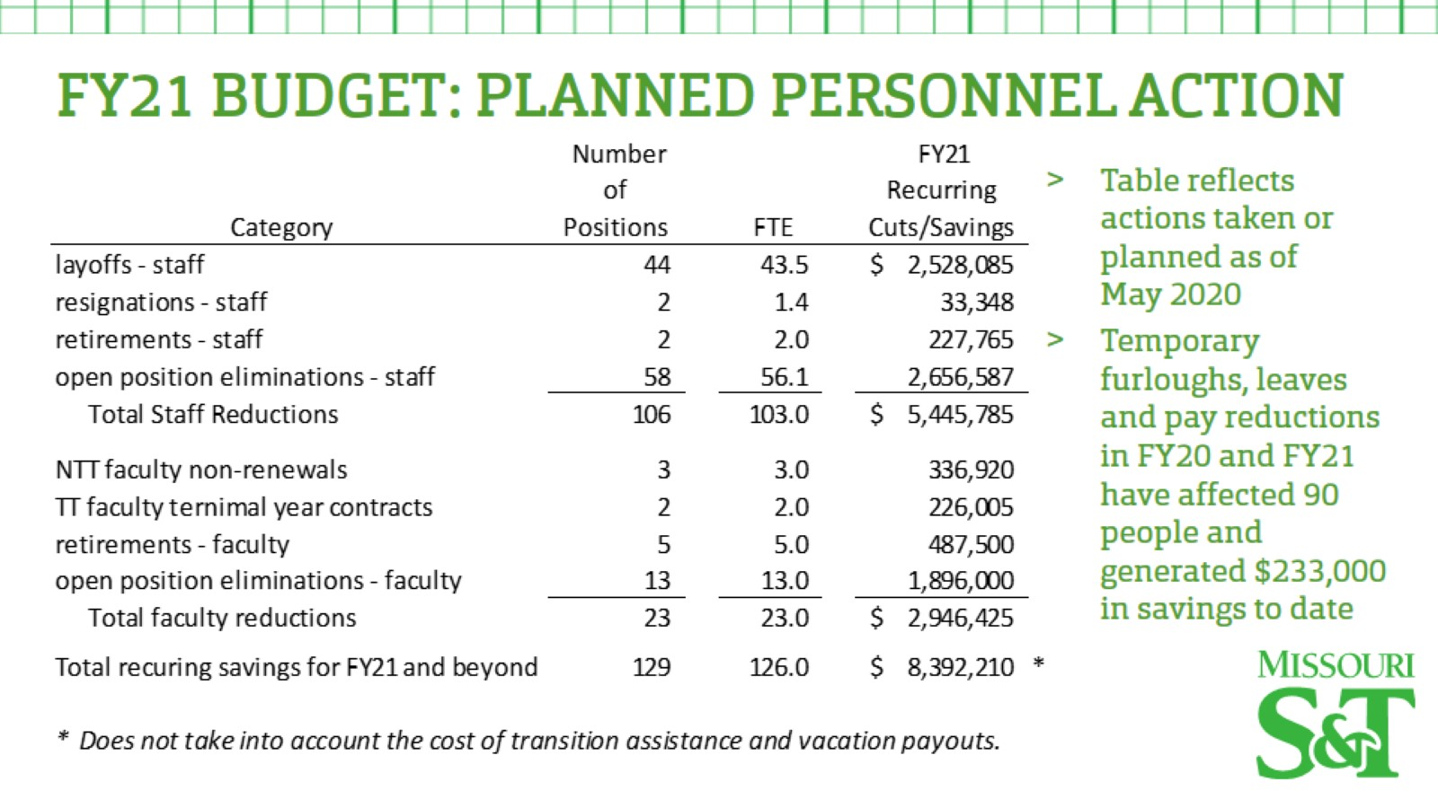

Slide 52
Agenda
VI. Administrative Reports
B. Provost’s Report

Slide 53
Steve Roberts
Interim Provost and Executive Vice Chancellor of Academic Affairs
Report to Faculty Senate
June 11, 2020

Slide 54
Status of Fall Semester of 2020
No change to the start date of the fall semester calendar.
Learning Transition Team, Facilities Management, Colleges, Departments, CAFÉ, and Academic Support are working on course, instructor, and facility preparedness for instruction that will happen in-person or remotely (in part or full).
ALL COURSES AND INSTRUCTORS SHOULD BE PREPARED TO TRANSITION TO REMOTE INSTRUCTION AT ANYTIME, DEPENDING ON PREVAILING COVID-19 CONDITIONS.

Slide 55
Status of Fall Semester of 2020, cont.
All understand that there will be some faculty whose individual circumstances will prevent them from teaching in-person, and we are working with colleges and departments now to understand the scale of the issue, and the range of possible accommodations.
Campus guidelines for social distancing, protective coverings, physical barriers, hygiene, etc. are being developed per recommendation of the CDC and ACHA.
How we will run our enterprises for learning, discovery, and engagement will be mindful of all aspects of wellness: physical, emotional , intellectual, social, spiritual, environmental, and occupational.

Slide 56
Academic Calendar Possibility Thinking
A semester that begins in October 2020 and runs through January 2021. (and maybe every academic year)
So that new international graduate students can come if travel restrictions, health conditions, and visa processing allows. This would allow them to take classes for two semesters (this one and SP2021), and be eligible for OPT in summer 2021. Strong interest from our admitted students. Being considered for select Comp Sci and ECE courses.
So that students, particularly freshmen, enrolled in fall classes can restart a fall semester class in which they falter. Being considered for certain introductory math classes, and perhaps other high DFW classes as appropriate. Allows them to stay on pace for degree.
A 4-wk winter/intersession for select courses.

Slide 57
“Direct Admission” to major
Direct admission to a major is a competitive recruiting advantage.
Many departments have (or had) a direct admission option.
I would ask that all departments who do not have a direct admission option to please consider developing one.
The direct admission criteria can be selective, with the direct admission to highly academically-qualified students.
The experience for a direct admit versus a non-direct admit may not be that much different, but the cache of being directly admitted is a lure for recruiting students.
If a department chooses to advise 1st-year direct admits, then resources can be made available to support this.

Slide 58
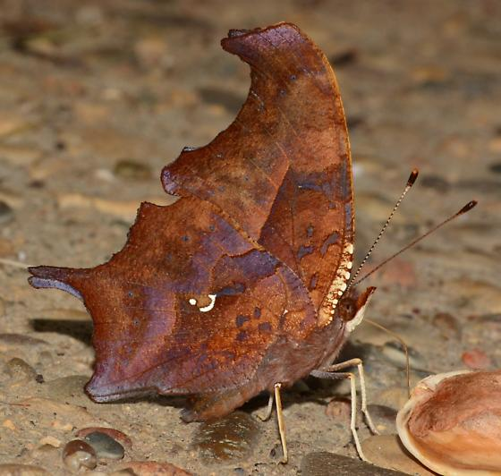
Questions?
Copyright © 2018 dan40165

Slide 59
Agenda
VII. Reports of Standing Committees
A. Academic Freedom and Standards
K. Kosbar

Slide 60
Grading and
On-Line Instruction
11 June 2020
K. Kosbar
Chair, Academic Freedom & Standards Committee

Slide 61
Summary of S/U Grading in SP20
17% of SP20 grades were changed to S/U
2,100 undergraduates changed a total of 4,200 grades to S/U
60 graduate students changed a total of 70 grades to S/U
10 A’s changed to S
1,600 B’s changed to S
2,000 C’s changed to S
350 D’s changed to U
300 F’s changed to U
Several students preserved their 4.0 GPA by changing B’s to S
All data above are approximate. Precise data, and additional statistics, are available upon request.

Slide 62
Summary of S/U Grading in SP20
Subject | % S/U |  | Subject | % S/U
PHYSICS | 29 |  | MUSIC | 12
FRENCH | 28 |  | FR ENG | 12
MATH | 26 |  | ERP | 12
CHEM ENG | 21 |  | MET ENG | 12
STAT | 19 |  | HISTORY | 12
ENGLISH | 19 |  | ARCH ENG | 11
CIV ENG | 19 |  | NUC ENG | 11
PET ENG | 18 |  | CER ENG | 11
ELEC ENG | 18 |  | SPANISH | 10
COMP SCI | 18 |  | FINANCE | 10
MECH ENG | 18 |  | ENV ENG | 10
GEOLOGY | 17 |  | ART | 10
ECON | 17 |  | PSYCH | 10
COMP ENG | 17 |  | ENG MGT | 10
AERO ENG | 17 |  | SYS ENG | 9
GEO ENG | 15 |  | BUS | 9
PHILOS | 15 |  | SP&M S | 9
POL SCI | 14 |  | IS&T | 9
BIO SCI | 14 |  | EDUC | 5
CHEM | 14 |  | TCH COM | 5
MIN ENG | 13 |  | EXP ENG | 3
 |  |  | MKT | 2
Subjects with
very few grades
omitted

Slide 63
Motion to Clarify SP20 S/U Grading
The Faculty Senate wishes to clarify some issues regarding the change in the grading basis for spring semester 2020, approved at the special Faculty Senate on 2 April 2020.
1. On 2 April 2020, the Faculty Senate stated that a grade of "S" earned in spring semester 2020 will satisfy all prerequisite and graduation requirements which require a "C" or higher grade.
The Senate was silent on the issue of an "S" grade satisfying a "B" or higher grade requirement, which is part of some graduate student academic requirements.
The Senate anticipates the Graduate Faculty may wish to address this, and issue guidance to graduate students, academic departments, and the registrar's office.
(continued on next page)

Slide 64
Motion to Clarify SP20 S/U Grading
2. If a student takes a class off-campus in spring 2020 on a pass/fail scale, and earns a passing grade, it shall transfer to S&T as an "S" grade. This grade will satisfy all the pre-requisite and graduation requirements which a spring semester 2020 S&T "S" grade satisfies.
3. If a student takes a class off campus in spring 2020, on an A/B/C/D/F basis, then the grade assigned in that class will be transferred to S&T as it does in every other semester. The student will not be given an opportunity to convert it to the S/U grading scale at S&T.
(end of motion)

Slide 65
Guidance on SS 20 Grading, and Beyond
Questions have been raised about if/when S/U grading will be available again
Never?
If all courses go on-line?
If one course goes on-line?
If a student is placed in quarantine?
AF&S committee recommends the top choice, with the motion:
At this time the Faculty Senate anticipates using conventional grading scales for summer semester 2020, fall semester 2020, and into the foreseeable future. Instructors and students should be aware that a change to all on-line education, on short notice, is possible - and plan accordingly.

Slide 66
Guidance on Equipment, Services, Environment
There have been misunderstandings between instructors and students regarding what equipment, services and environments an on-line student may be required to provide.
Reliable internet access during class meetings
Ability to text message / chat during class meetings
Webcam / microphone / camera / scanner
Desktop / laptop computer
Software specific to the course
Software license or services specific to the course
Low distraction / noise environment
Conventional desktop or work area

Slide 67
Guidance on Equipment, Services, Environment
Some instructor concerns
Participation during lectures may be integral part of course
Monitoring when a student has stopped participating in a course is required for students receiving U or F grades
Student presentations may be integral part of course
May need to verify examinations are an individual effort
May format distance material using a specific software service which augment Canvas

Slide 68
Guidance on Equipment, Services, Environment
Some student concerns
Cost
Availability, especially if moving to on-line on short notice
Internet service may be unavailable, especially if quarantined at rural location
Difficulty of locating area where they are free to talk / work
IT security
FERPA security
Software/services may harvest biometric and other data

Slide 69
Guidance on Equipment, Services, Environment
AF&S committee evenly split on the following motion:
If students are unable, or prohibited, from attending a course, instructors will have an on-line version available which will provide students with a comparable learning experience. To provide this experience, an instructor may require students have access to the following during normal class meeting times:
Laptop or desktop computer equipped with a webcam, microphone and speaker
A reliable internet connection which can support two-way video and audio communication
A location where students are able to use their webcam and microphone, speak freely, and have a desktop area where they can work
Additional course-specific hardware, software, and services
Instructors will define the software, hardware, services, space and connectivity requirements for the course in the syllabus distributed during the first week of the semester.

Slide 70
Agenda
VII. Reports of Standing Committees
B. Budgetary Affairs
M. Fitch
-NO REPORT

Slide 71
Agenda
VIII. New Business

Slide 72
Agenda
IX. Adjourn

